Slide 1
Lake Shore Marketplace
By
Lahari Tumkur Nataraj
Olga Velichko
Vamsi Gollapalli

Slide 2
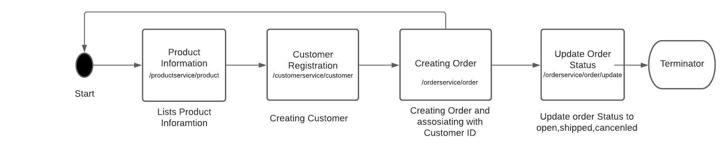
Workflow
High level Workflow

Slide 3
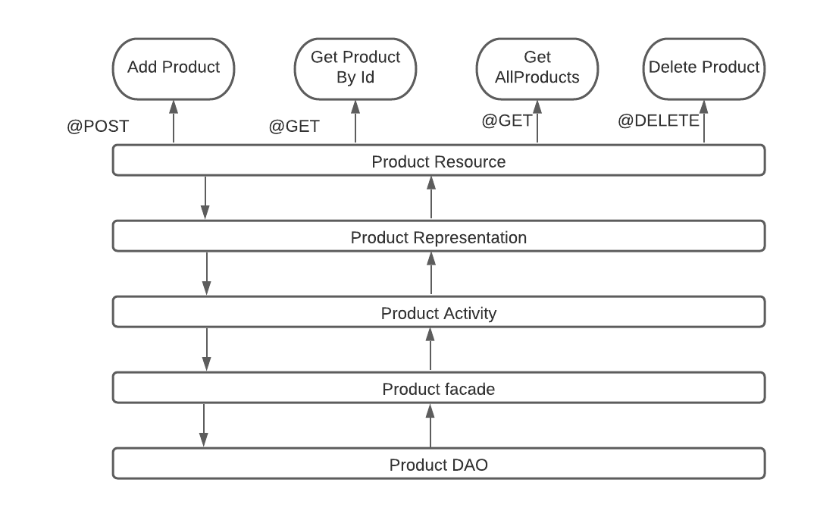
Product Implementation Architecture

Slide 4
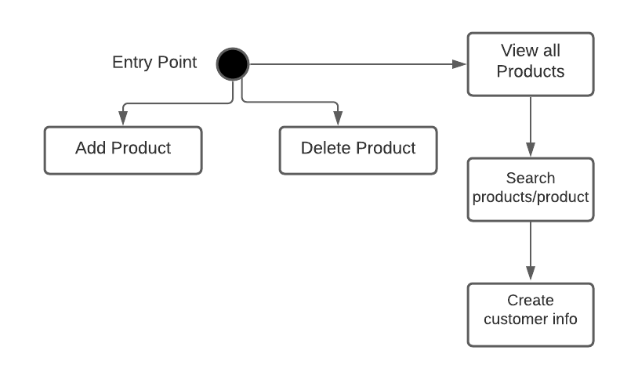
Product Workflow

Slide 5
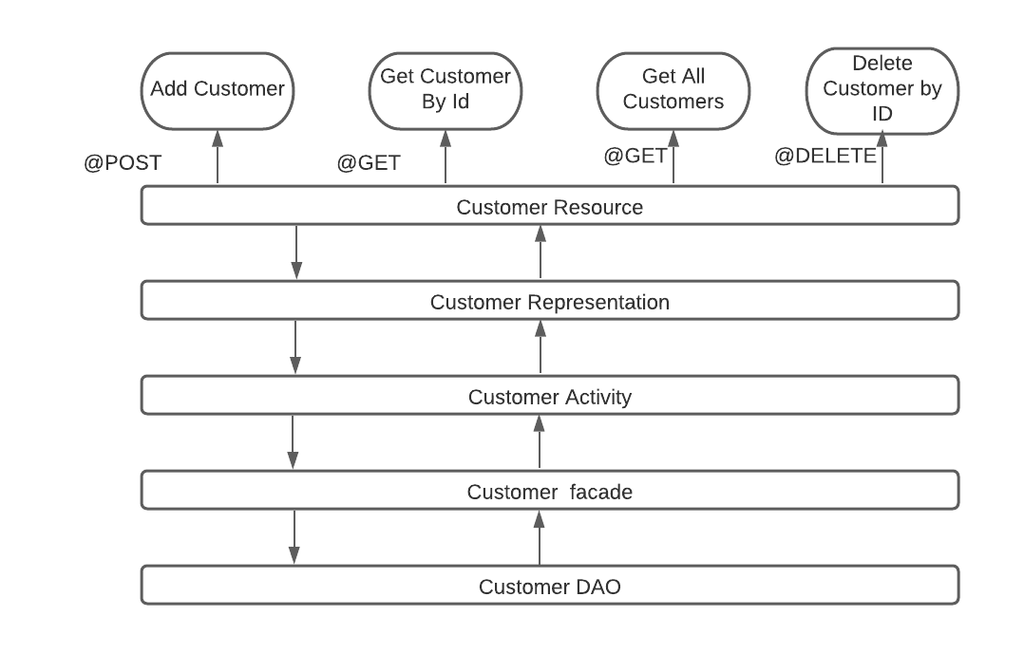
Customer Implementation Architecture

Slide 6
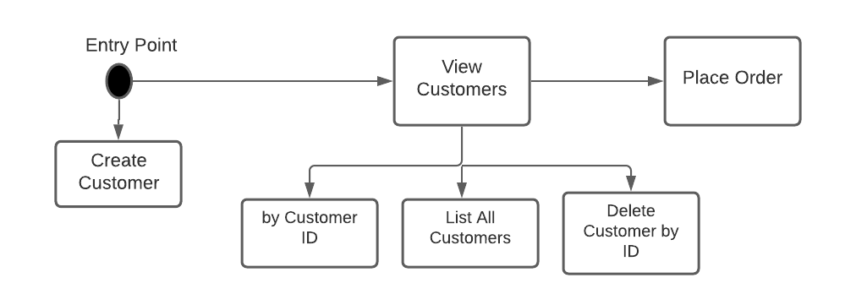
Customer Workflow
Notes:
Vams

Slide 7
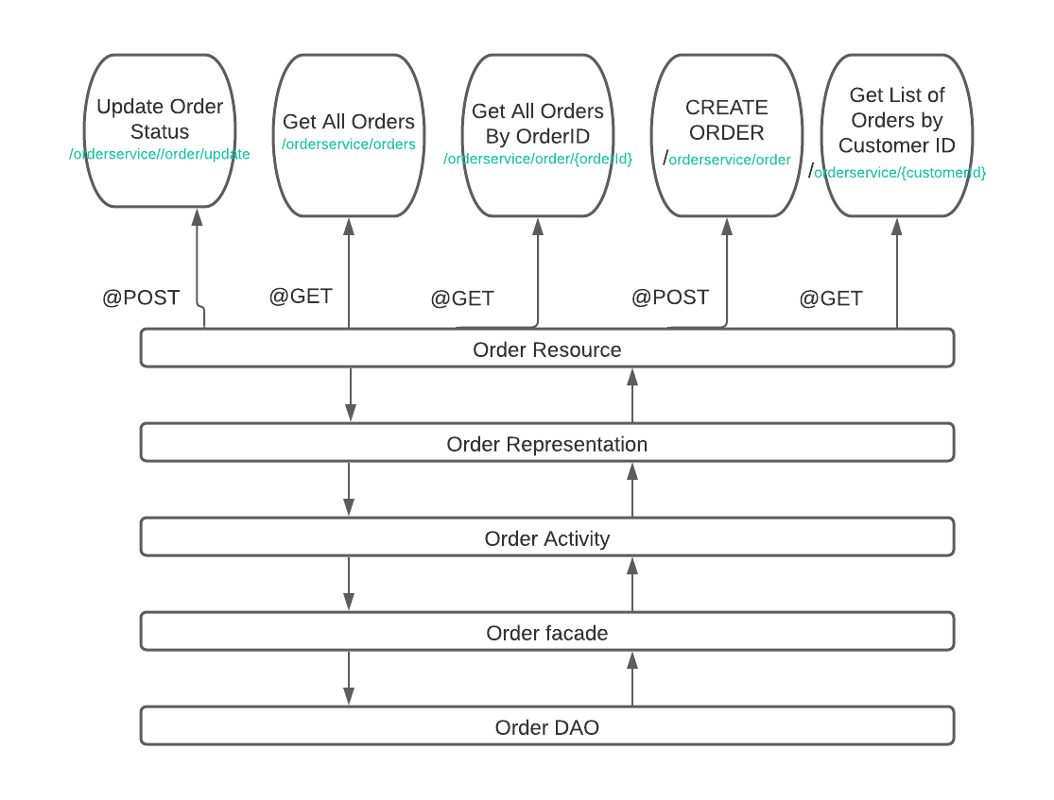
Order Implementation Architecture
Notes:
Vams

Slide 8
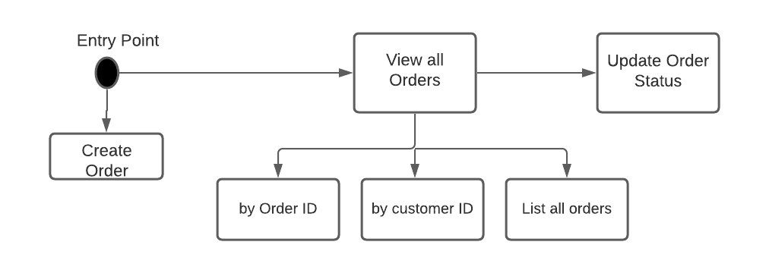
Order Workflow
Notes:
Vams

Slide 9
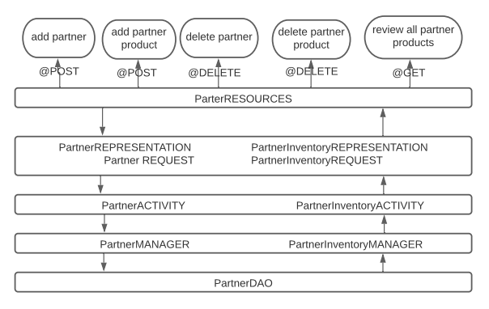
Partner Implementation Architecture

Slide 10
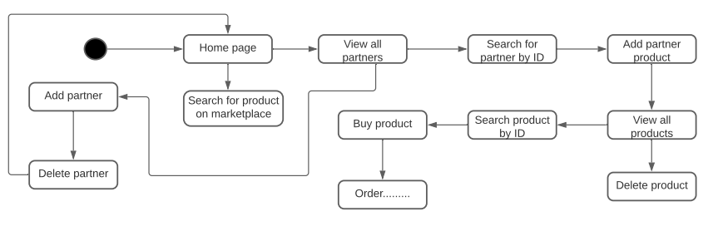
Partner workflow

Slide 11
Thank you!

